Slide 1
Pixelate
Workshop
Computer Vision

Slide 2
Please Download the Workshop files
bit.ly/PixelateWorkshop2

Slide 3
Quiz

Slide 4
Q1: What is the difference between
a = 42
print (a/14)
print (a//14)

Slide 5
a = 42
print (a/13) # Normal division always gives float
>>> 3.230769230769231
print (a//13) # Integer division gives quotient only
>>> 3

Slide 6
Q2: What will happen
a = [1,2,46]
b = np.array( [1,2,46] )
print (a + 32)
print (b + 32)

Slide 7
a = [1,2,46]
b = np.array( [1,2,46] )
print (a + 32)
>>> TypeError: can only concatenate list (not "int") to list
print (b + 32) # Vectorization
>>> np.array([33,34,78 ])

Slide 8
Q3: What will happen
a = ( ‘sad duck’, 77, False )
a[-1] = ‘pringles’
b = ‘candy’
print (a)
print (b[:-2] + ‘sister’[1:] )

Slide 9
a = ( ‘sad duck’, 77, False )
a[-1] = ‘pringles’
>>> TypeError: 'tuple' object does not support item assignment
print (b[:-2] + ‘sister’[1:] )
>>> canister

Slide 10
Q4: What will happen
a = np.arange(60).reshape(10,2,3)
b = a [ : , 1: -1, 1]
print (b.shape)
print (b.T.shape)

Slide 11
a = np.arange(60).reshape(5,4,3)
b = a [ : , 1: 3, 1]
print (b.shape) >>> (5,2)
print (b.T.shape) >>> (2,5)

Slide 12
Q5: What will happen
a = np.eye(2)
b = np.ones((2,2))
print (a * b)

Slide 13
Q6: What will happen
a = np.eye(2)
b = np.ones((2,2))
print (a * b)
>>> np.array([ [ 1 , 0 ],
[ 0 , 1 ] ])
print (a @ b) # What is the Output

Slide 14
Image Processing:
Image processing is a method to convert an image into digital form and perform some operations on it, in order to get an enhanced image or to extract some useful information from it.
Image processing basically includes the following three steps:
Input
Analysis and Manipulation
Output

Slide 15
How to install OpenCV
Open cmd or terminal with administrator privileges.
pip install opencv-python

Slide 16
OpenCV
OpenCV is an Image Processing library created by Intel and maintained by Willow Garage.
Available for C, C++, and Python.
Open Source and free.
Easy to use and install

Slide 17
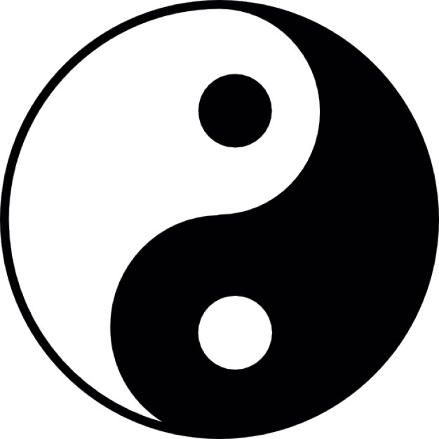
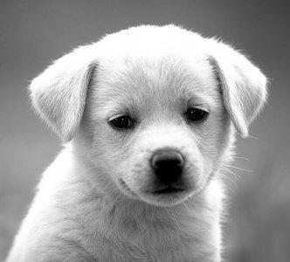
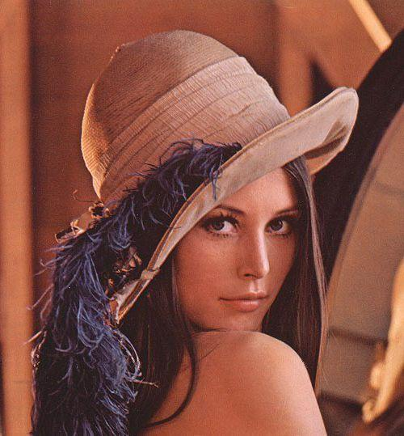
Images:
Binary Image
Grayscale Image
RGB Image

Slide 18
Images in OpenCV:
Binary
Image
All the elements of the matrix are either zero or one.
Zero represents black and 1 represents white.
Grayscale Image
All the elements of the matrix lie between 0 and 255.
Zero represents Black, 255 represents White and the intermediate values represent shades of Gray.
RGB
Image
Each colour has a specific RGB value!
RGB Images are seen as 3D matrices with the 1st plane corresponding to R, 2nd to G and 3rd to B.

Slide 19
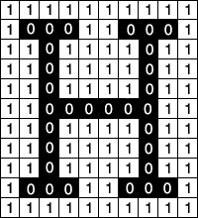
Binary Image: (a x b) array of 0 or 1

Slide 20
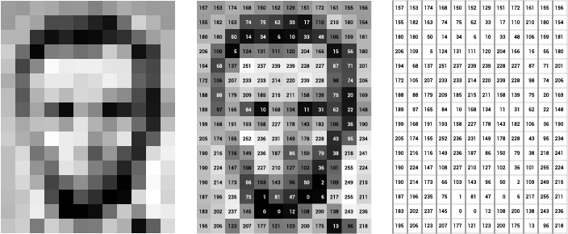
Grayscale Image: a x b image of values from 0-255

Slide 21
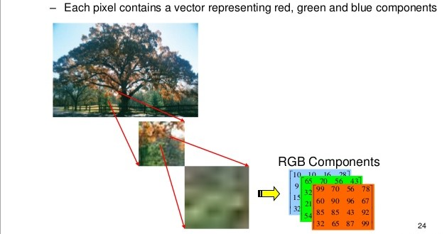
Images in MATLAB & the rest of the world:
RGB Image:

Slide 22
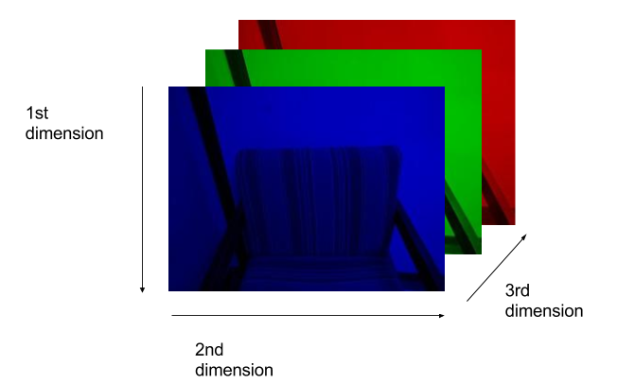

Images in OPENCV:
BGR Image: a x b x 3 (0-255)

Slide 23
Images in OpenCV:
Each image is seen as an array of size equal to the number of pixel rows x number of pixel columns x number of channels.
The indexing in an image is (y,x) or (column, row)
Each pixel has a value of intensity.
Each element of the matrix contains the value of this intensity at the corresponding to the pixel it represents.

Slide 24
cv2.imread() : Read the image
image = cv2.imread(r‘C:/mypath/myimage.png’)
First argument is the name of image. The full path of image should be given or relative path.
Second argument is a flag which specifies the way image should be read.
cv2.IMREAD_COLOR Flag : 1
cv2.IMREAD_GRAYSCALE Flag : 0
cv2.IMREAD_UNCHANGED Flag : -1

Slide 25
cv2.imwrite() : Saves the image
First argument is file name which is a string.
Second argument is the image you want to save.
cv2.imwrite('image.png',img)
This will save the image in PNG format in the working directory.

Slide 26
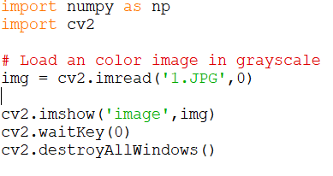
cv2.imshow() : Display the image
First argument is a window name which is a string.
Second argument is our image.
The cv2.waitKey(n) function in OpenCV is used to introduce a delay of n milliseconds while rendering images to windows. cv2.Waitkey(0) shows image until you close it.

Slide 27
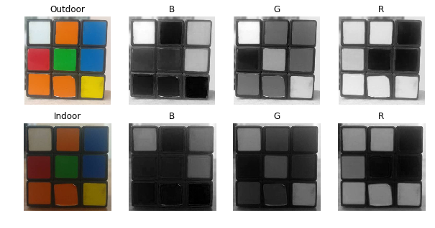
What will be shown?
img = cv2.imread (‘cube.png’)
layer = img[ : , : ,2]
cv2.imshow(‘mywindow’, layer)
cv2.waitKey(0)

Slide 29
Resizing and Cropping
Resizing is done by cv2.imresize() function with arguments as image and shape of desired image.
new_img=cv2.resize(old_img,(new_y,new_x) ) #to a given size
new_img=cv2.resize(old_img, (0,0), fx=0.5, fy=0.5) #to half size
⬆️----- it's a placeholder
Cropping is done using NumPy slicing.
crop_part = img[10:900, 120:700]

Slide 30
Changing Colorspaces
newimg=cv2.cvtColor( img, FLAG ) is used to convert image from one color space to other .
For Ex ,flag:
cv2.COLOR_BGR2GRAY converts BGR image to Grayscale.
cv2.COLOR_GRAY2BGR converts Grayscale to RGB image.
cv2.COLOR_BGR2RGB converts BGR to RGB image.
cv2.COLOR_BGR2HSV converts BGR to HSV.

Slide 31
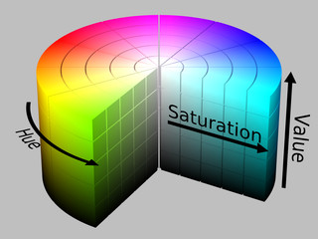
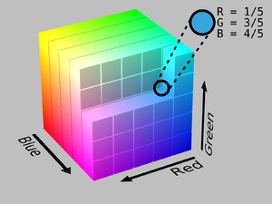
RGB
HSV

Slide 32
Analysis and Processing
Conversion to Binary(Basics):
Less information in binary => Computational Ease
Can focus on only the area of interest
Most of the analysis can be done on Binary only.

Slide 33
Thresholding:
Thresholding is the simplest segmentation method.
The pixels are partitioned depending on their BGR values.
Global thresholding, using an appropriate threshold T:
True or 1, if f(x,y) > T
g(x, y) =
False or 0, if f(x,y)<= T

Slide 34
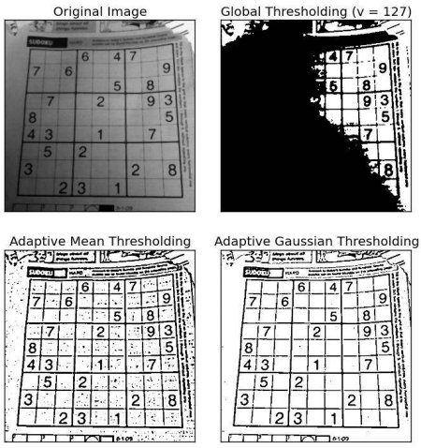
global_thresh = orig_imag > 127
Black and White Grayscale

Slide 35
Other Type of Thresholding: use cv2.threshold

Slide 36
cv2.inrange(image, lower_range,upper_range )
Lower range defines the array of lower values of required color.
Upper range defines the array of upper values of required color.
B G R
lower_blue = np.array([100,200,0])
upper_blue = np.array([200,255,55])
newblue =cv2.inRange(new,lower_blue,upper_blue)

Slide 37
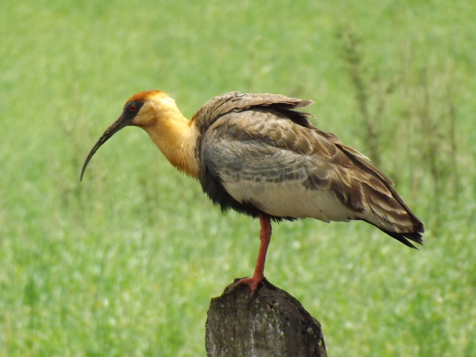
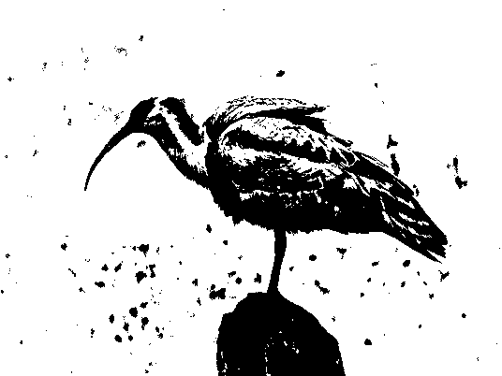
We chose this color

Slide 38
Morphological Operations
What is Kernel ???
Erosion:
All the pixels near boundary will be discarded depending upon the size of kernel.
kernel = np.ones((5,5),np.uint8) erosion = cv2.erode(img,kernel,iterations = 1)

Slide 39
Morphological Operations
Dilation:
Just opposite of erosion i.e. increases white area.
kernel = np.ones((5,5),np.uint8) dilation = cv2.dilate(img,kernel,iterations = 1)

Slide 40
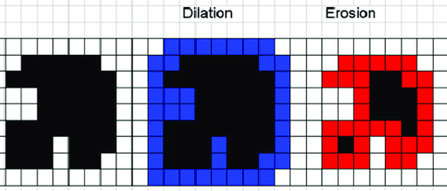

Slide 41
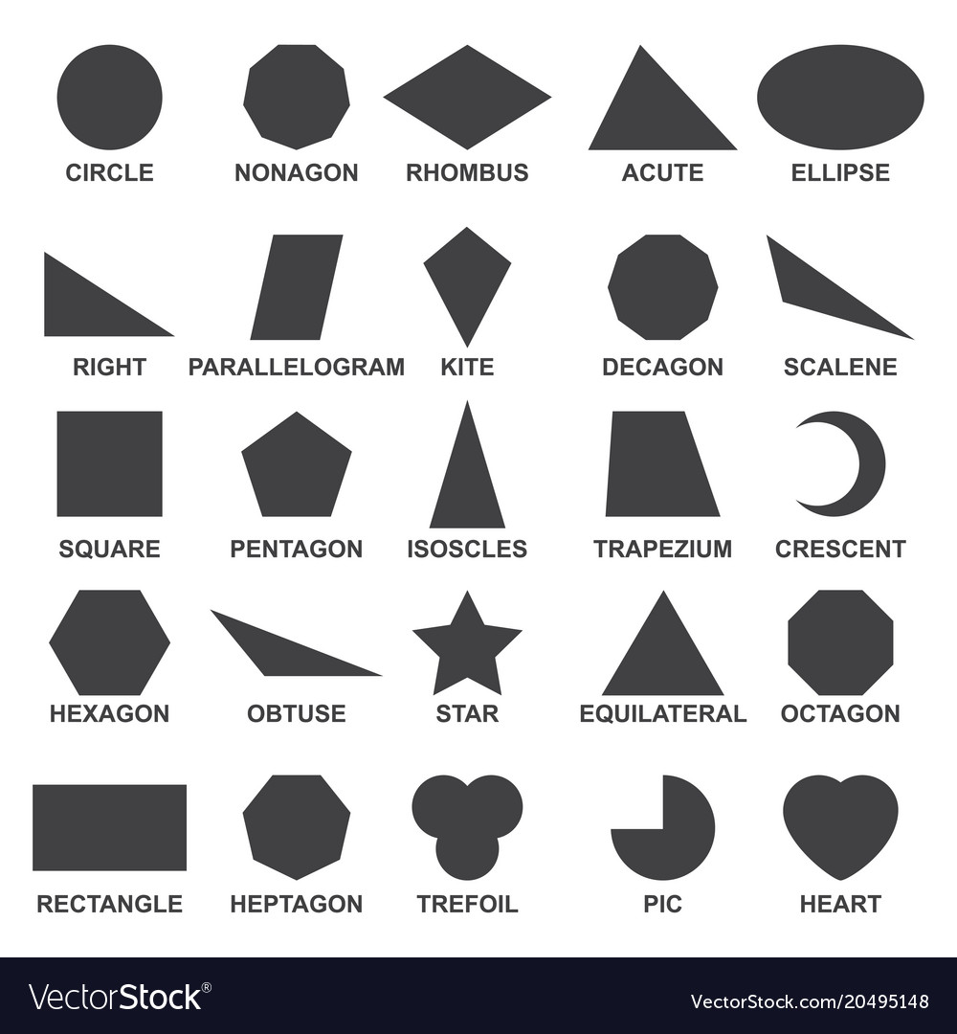
Shape detection:
Shape detection is one of the basic tools in image processing.
We will leverage contour properties to actually label and identify some simple shapes in an image.

Slide 42
Contours:
Contours can be explained simply as a curve joining all the continuous points (along the boundary), having same color or intensity.
The contours are a useful tool for shape analysis and object detection and recognition.
For better accuracy, use binary images.

Slide 43
img,contours,hierarchy_ = cv2.findContours(blue,cv2.RETR_TREE,cv2.CHAIN_APPROX_SIMPLE)
Arguments:
First one is source image.
Second is contour retrieval mode.
Third is contour approximation method.’
Outputs:
Image : Source, an 8-bit single-channel image
Contours : Detected contours. Each contour is stored as a vector of points.
Hierarchy : Optional output vector, containing information about the image topology.

Slide 44
Contour Features
Moments:
The function cv2.moments() gives a dictionary of all moment values calculated.
From this moments, you can extract useful data like area, centroid etc.
Centroid :
cx = int(M['m10']/M['m00'])
cy = int(M['m01']/M['m00'])

Slide 45
Contour Features
Area : Contour area is given by the function cv2.contourArea() or from moments, M[‘m00’].
Area = cv2.contourArea(contours[index])
Perimeter : Contour perimeter is given by the function cv2.arcLength().
Perimeter = cv2.arcLength(contours[index], True)
Second argument specifies whether shape is a closed contour (if passed True), or just a curve.

Slide 46
Contour Features(contd)
Bounding Rectangle : It is the rectangle that will enclose the contour. It is of two types:
Straight Bounding rectangle: It is a straight rectangle, it doesn’t consider the rotation of the object. So area of the bounding rectangle won’t be minimum. It is found by the function cv2.boundingRect().
Let (x,y) be the top-left coordinate of the rectangle and (w,h) be its width and height.
x,y,w,h = cv2.boundingRect(cnt)
img = cv2.rectangle(img,(x,y),(x+w,y+h),(0,255,0),2)

Slide 47
Contour Features(contd)
Rotated rectangle: Here, bounding rectangle is drawn with minimum area, so it considers the rotation also.
The function used is cv2.minAreaRect(). It returns a Box2D structure which contains following details - ( top-left corner(x,y), (width, height), angle of rotation ).
But to draw this rectangle, we need 4 corners of the rectangle. It is obtained by the function cv2.boxPoints()
rect = cv2.minAreaRect(cnt)
box = cv2.boxPoints(rect)
box = np.int0(box)
im = cv2.drawContours(im,[box],0,(0,0,255),2)

Slide 48
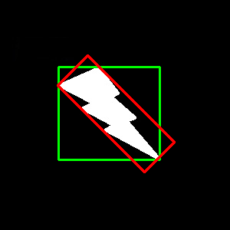
Contour Features(contd)
Both the rectangles are shown in a single image. Green rectangle shows the normal bounding rect. Red rectangle is the rotated rect.

Slide 49
Contour Approximation:
It approximates a contour shape to another shape with less number of vertices depending upon the precision we specify.
To understand this, suppose you are trying to find a square in an image, but due to some problems in the image, you didn’t get a perfect square, but a “bad shape”.
Now you can use this function to approximate the shape. In this, second argument is called epsilon, which is maximum distance from contour to approximated contour. It is an accuracy parameter. A wise selection of epsilon is needed to get the correct output.
Third argument specifies whether curve is closed or not.

Slide 50
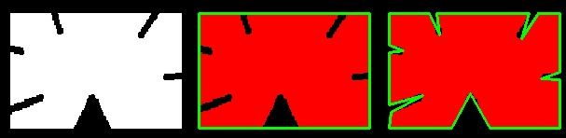
Contour Approximation(contd):
epsilon = 0.1*cv2.arcLength(contours[index],True)
approx = cv2.approxPolyDP(contours[index],epsilon,True)
Below, in second image, green line shows the approximated curve for epsilon = 10% of arc length. Third image shows the same for epsilon = 1% of the arc length.

Slide 51
Detecting shapes using contour approximation:
We can use the fact that triangle has three vertices, rectangle has four vertices and so the remaining ones will be circle.
img = cv2.imread("shapes.jpg", cv2.IMREAD_GRAYSCALE)
_, threshold = cv2.threshold(img, 240, 255, cv2.THRESH_BINARY)
_, contours, _ = cv2.findContours(threshold, cv2.RETR_TREE, cv2.CHAIN_APPROX_SIMPLE)
for cnt in contours:
approx = cv2.approxPolyDP(cnt, 0.01*cv2.arcLength(cnt, True), True)
if len(approx) == 3:
print(“Triangle it is!”)
elif len(approx) == 4:
print(“Rectangle it is!”)
else:
print(“Circle it is!”)

Slide 52

Detecting shapes using some other methods:
Most of the simple geometrical shapes have some properties associated with them.
Let’s take an example:
For a circle, (area/(perimeter)²) is a constant equal to (1/(4*π)).
Can you guess something for rectangles too?

Slide 53
Video Processing:
Videos are extension of images in 4th dimension.
Frames can be BGR image or Grayscale or Binary image.

Slide 54
Video Processing:
Take a video
Do processing on each image as an individual frame
Output the processed image
Read the video
Separate frames from the video
Make an output video out of processed images

Slide 55
Video Processing:
To capture a video, you need to create a VideoCapture object.
Its argument can be either the device index or the name of a video file.
cap = cv2.VideoCapture(0)

Slide 56
cap = cv2.VideoCapture('begin.mkv')
while True:
ret,img = cap.read()
if ret == False:
break
# Processing Here
cv2.imshow('vid',img)
if cv2.waitKey(1) & 0xFF == ord('q'):
break
cap.release()
cv2.destroyAllWindows()
cap = cv2.VideoCapture('begin.mkv')
while True:
ret,img = cap.read()
if ret == False:
break
# Processing Here
cv2.imshow('vid',img)
if cv2.waitKey(1) & 0xFF == ord('q'):
break
cap.release()
cv2.destroyAllWindows()

Slide 57
PySerial
pySerial is a Python API module to access the serial port to communicate with devices like Arduino.
To install Open cmd or terminal with administrator privileges.
pip install pyserial

Slide 58
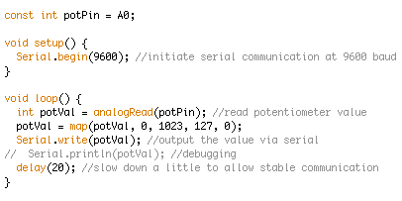
On Arduino Code

Slide 59
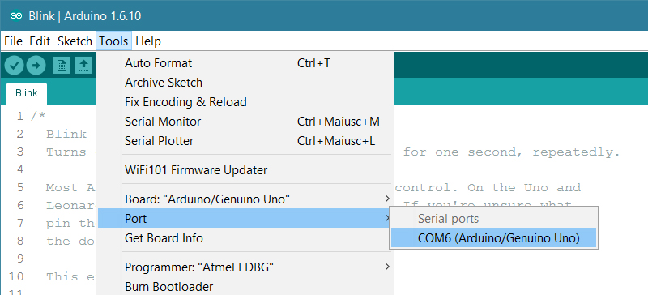

Slide 60
On Python side running on your Computer
import serial # not pyserial
# on linux open port
ser = serial.Serial('/dev/ttyUSB0', 9600) #9600 is Arduino Baudrate
# on Windows open port
ser = serial.Serial('COM3',9600)
# write a string to Arduino
ser.write(b'hello') #b means bytestring
# read a string from Arduino
output=ser.read()
# close port
ser.close()

